Slide 1





B.TECH MAJOR PROJECT PRESENTATION 2024-25
Advance Cyclone alert system for weather forecasting using Machine Learning
Project ID: 31210
Student 1: Subrata Kumar Sahu
Roll No: 202110040
Student 3: Anwesh Misra
Roll No: 202110068
By
Student 2: Soumya Kanta Moharana
Roll No: 202110043
Student 4: A. Sai Satyanarayana
Roll No: 202140086
Under the guidance of
Dr. Pradeep Kumar Jena
1
Notes:
B-TECH PROJECT MID-SEM PRESENTATION 2011
BY KHUSHBU KHAN & ISAN SAHOO

Slide 2
CONTENT
B.TECH MAJOR PROJECT PRESENTATION 2024-25
Problem Statement
Objective
Introduction
Dataset Description
Methodology
Proposed System
Results and Discussion
Conclusion and Future Work
References
202110040 Subrata Kumar Sahu
202110068 Anwesh Misra
202140086 A. Sai Satyanarayana
202110043 Soumya Kanta Moharana
2

Slide 3
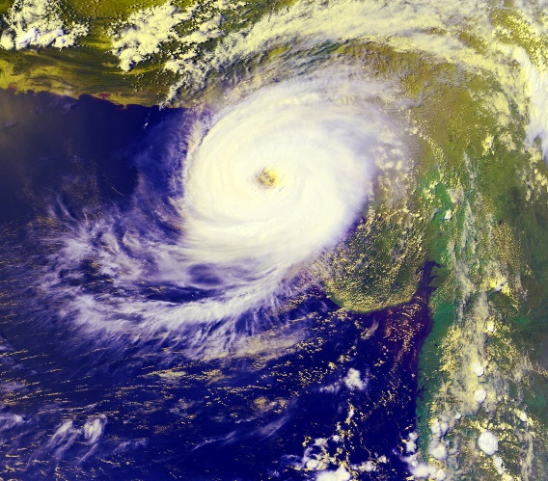
B.TECH MAJOR PROJECT PRESENTATION 2024-25
Cyclones are among the most destructive natural disasters, causing significant damage to life, infrastructure, and the economy.
While meteorological agencies provide general warnings, there is a critical need for a more localized, precise, and timely alert system that can cater to the specific needs of affected populations.
Existing systems often fail to offer personalized, real-time alerts based on the user's exact location, leading to delayed responses and inadequate preparedness.
202110040 Subrata Kumar Sahu
202110068 Anwesh Misra
202140086 A. Sai Satyanarayana
202110043 Soumya Kanta Moharana
3

Slide 4
B.TECH MAJOR PROJECT PRESENTATION 2024-25
The aim is to develop an advanced cyclone alert system that:
Utilizes historical weather data, deep learning, and location-based storm predictions.
Analyzes and classifies cyclones based on intensity before time, allowing for timely safety measures.
Reduces potential loss of life and property by enhancing preparedness through precise and early warnings.
202110040 Subrata Kumar Sahu
202110068 Anwesh Misra
202140086 A. Sai Satyanarayana
202110043 Soumya Kanta Moharana
4

Slide 5
B.TECH MAJOR PROJECT PRESENTATION 2024-25
INTRODUCTION
Cyclones cause severe coastal damage. Despite advancements, predicting their formation and intensity remains difficult, necessitating reliable forecasting for better preparedness in vulnerable areas.
Cyclone forecasting faces challenges due to system complexity. Improved model resolution and physical process representation enhance accuracy, allowing for better warnings.
Deep learning models like Simple RNN, GRU and LSTM analyze weather patterns, capturing temporal relationships and improving cyclone formation and intensity predictions over traditional methods.
RNN, GRU and LSTM excel in cyclone forecasting by retaining context and capturing long-term dependencies, helping model complex cyclone data effectively.
Deep learning aids cyclone risk assessment, identifying vulnerable regions for targeted preparedness. It promises to revolutionize cyclone forecasting, reducing impacts on affected areas.
202110040 Subrata Kumar Sahu
202110068 Anwesh Misra
202140086 A. Sai Satyanarayana
202110043 Soumya Kanta Moharana
5

Slide 6
B.TECH MAJOR PROJECT PRESENTATION 2024-25
Research Study | Year | Methods Used | Results
Classification of Weather Conditions Based on Supervised Learning for Swedish Cities | 2023 | SVM, ANN, RF, KNN | Accuracy: ANN: 97.00% KNN: 77.97% RF: 96.69% SVM: 93.00%
Tropical Cyclone Intensity and Track Prediction in the Bay of Bengal Using LSTM-CSO Method | 2017 | LSTM | Accuracy: 95%
A Dual Stage Attention-Based Recurrent Neural Network for Time Series Prediction | 2017 | DA-RNN | Accuracy: 92%
Classification of cyclones using machine learning techniques | 2023 | Decision Tree, RF, Naïve-Bayes, SVM | Accuracy: Decision Tree: 96.51% Naïve-Bayes: 92.67% RF: 98.08% SVM: 92.82%
202110040 Subrata Kumar Sahu
202110068 Anwesh Misra
202140086 A. Sai Satyanarayana
202110043 Soumya Kanta Moharana
6

Slide 7
B.TECH MAJOR PROJECT PRESENTATION 2024-25
DATASET DESCRIPTION
RSMC Best Track Dataset (1982-2024)The dataset contains 7,961 records detailing tropical cyclone activity in the North Indian Ocean, including the Bay of Bengal (BOB) and the Arabian Sea (ARB), from 1982 to 2024.
Key Features:
Basin of Origin: Indicates where the system formed, predominantly in BOB (5,270 occurrences) and ARB (1,318 occurrences).
Date & Time (UTC): Provides timestamped cyclone observations.
CI No (T. No): Cyclone Intensity number, a crucial metric for storm classification.
Estimated Central Pressure (ECP): The atmospheric pressure at the cyclone’s center, ranging from 25 hPa (likely a data error) to 1010 hPa.
Maximum Sustained Wind Speed: Varies from 2 kt to 140 kt, indicating the storm's strength.
Grade (text): Classifies cyclones (e.g., Depression, Cyclonic Storm).
202110040 Subrata Kumar Sahu
202110068 Anwesh Misra
202140086 A. Sai Satyanarayana
202110043 Soumya Kanta Moharana
7

Slide 8
B.TECH MAJOR PROJECT PRESENTATION 2024-25
DATASET DESCRIPTION
Significantly, the dataset encompasses information from notable cyclones, enhancing its robustness for real-world applications.
These include:
Yaas (May 23, 2021 – May 28, 2021): A very severe cyclonic storm that made landfall in Odisha, India, shortly after Cyclone Tauktae.
Phailin (October 4, 2013 – October 14, 2013), hitting Eastern India, especially Odisha and Andhra Pradesh.
Amphan (May 13, 2020 – May 21, 2020): An extremely severe cyclonic storm that made landfall in West Bengal, India, and Bangladesh.
Hudhud (October 6, 2014 – October 14, 2014), impacting Eastern India, particularly Andhra Pradesh.
Fani (April 26, 2019 – May 4, 2019), striking Odisha, India, and parts of Bangladesh.
202110040 Subrata Kumar Sahu
202110068 Anwesh Misra
202140086 A. Sai Satyanarayana
202110043 Soumya Kanta Moharana
7

Slide 9
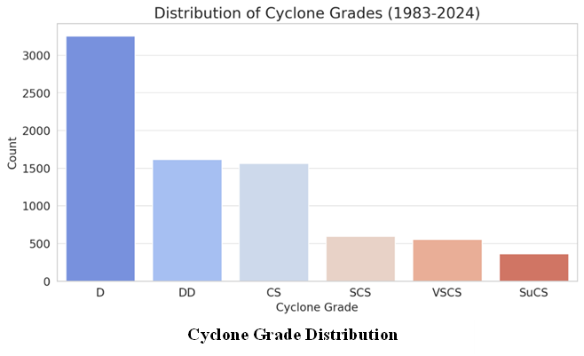
B.TECH MAJOR PROJECT PRESENTATION 2024-25
DATASET DESCRIPTION
202110040 Subrata Kumar Sahu
202110068 Anwesh Misra
202140086 A. Sai Satyanarayana
202110043 Soumya Kanta Moharana
7

Slide 10
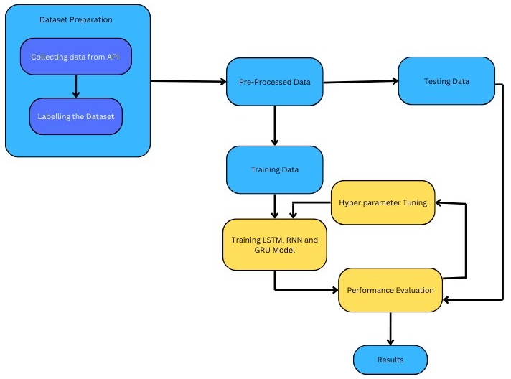
B.TECH MAJOR PROJECT PRESENTATION 2024-25
Dataset Preparation: Dataset preparation involves collecting time series data from a public dataset of RSMC-IMD Pune having data from 1983-2024.
Pre-Processing Data: Raw data from the dataset must be cleaned and pre-processed, which includes handling missing values, removing outliers, normalizing, and formatting for model training.
Splitting Data: The pre-processed data is split into training data for model development and testing data for evaluating model performance.
Model Training: Hyperparameter tuning optimizes settings like layers and learning rate, followed by training LSTM, GRU and Simple RNN models, each handling time series data with different strengths.
Performance Evaluation: The trained models are evaluated on the testing data to assess their performance. This involves calculating metrics like accuracy, precision, recall, and ROC curve.
Results: The final results of the model evaluation are presented, which can provide insights into the model's ability to make informed decisions based on the time series data.
202110040 Subrata Kumar Sahu
202110068 Anwesh Misra
202140086 A. Sai Satyanarayana
202110043 Soumya Kanta Moharana
9

Slide 11
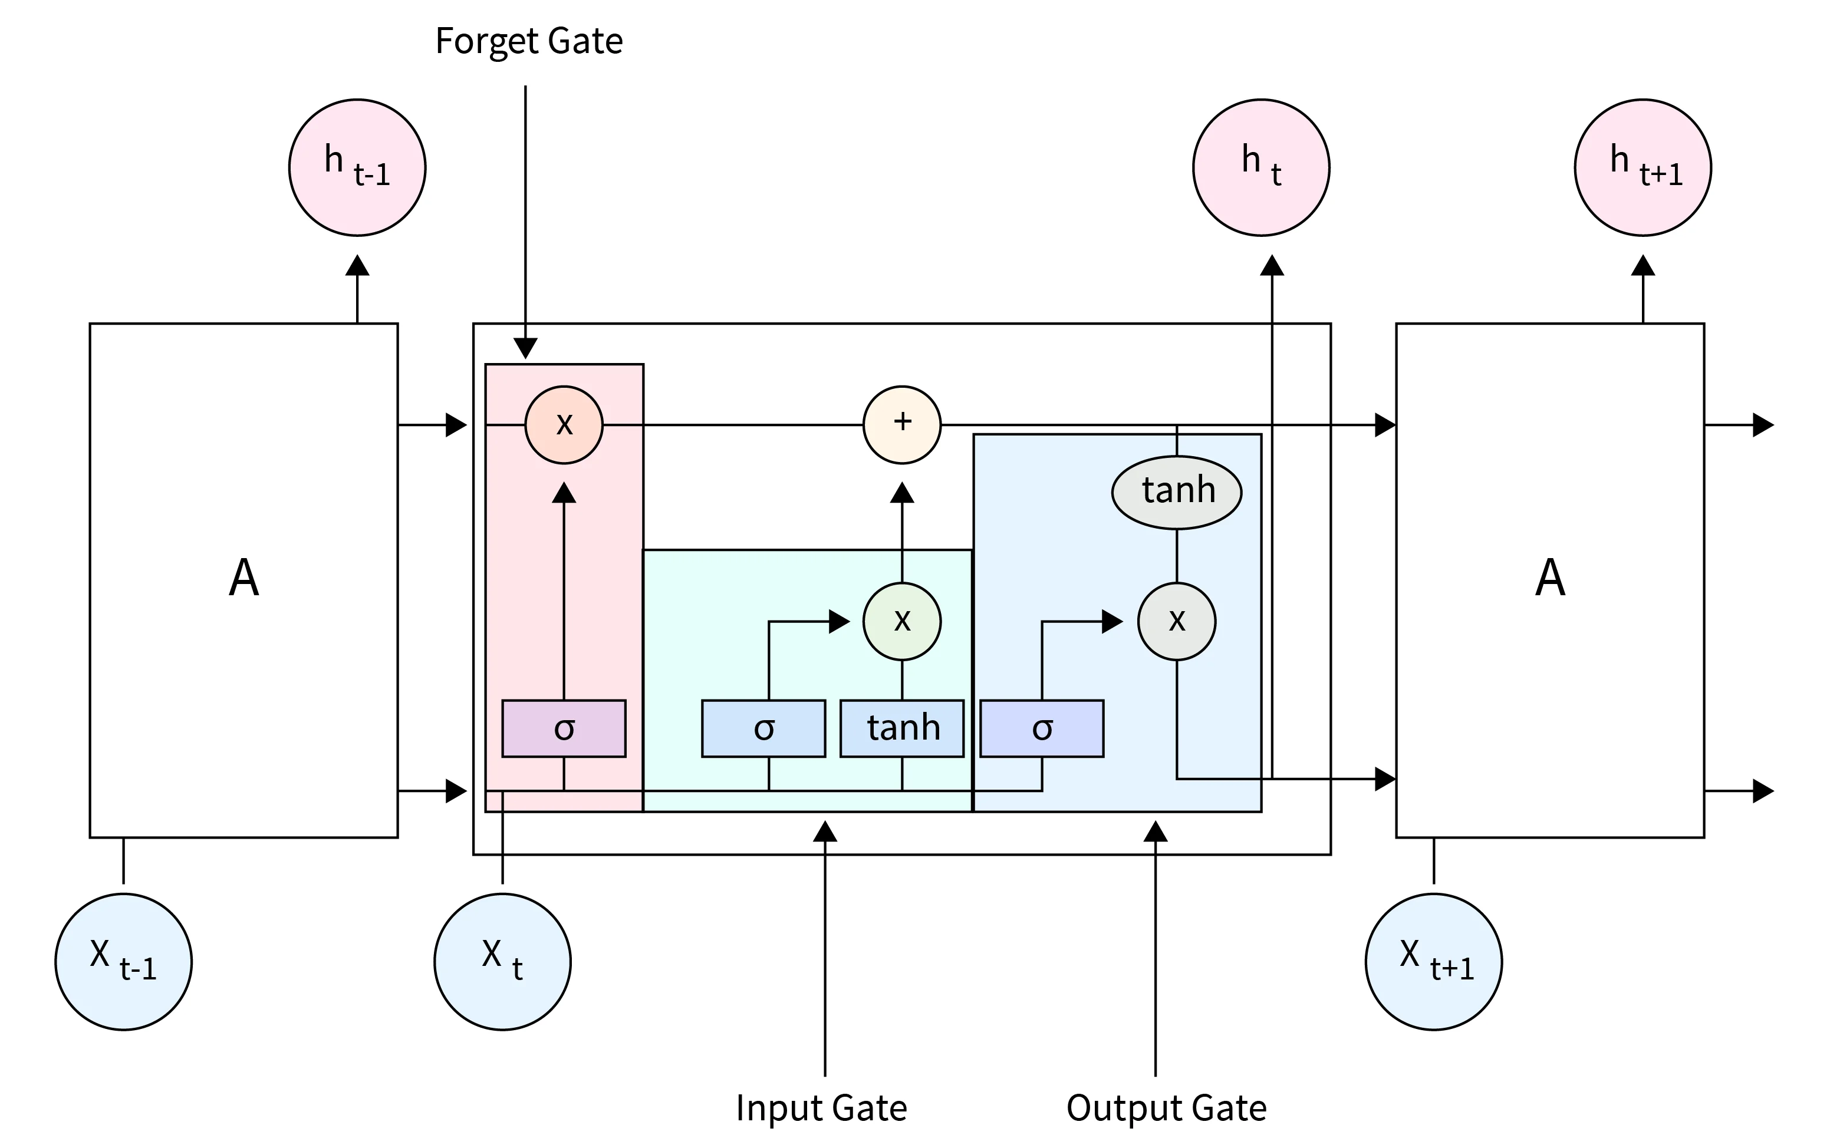
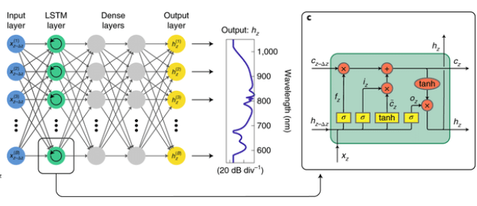
B.TECH MAJOR PROJECT PRESENTATION 2024-25
PROPOSED MODEL
LSTM (Long Short-Term Memory):
LSTM networks are a specialized type of Recurrent Neural Network (RNN) designed to handle sequential data and retain information over long periods.
LSTMs address the vanishing gradient problem that standard RNNs face, enabling them to learn long-term dependencies within sequences of data.
LSTMs contain unique memory cells that "remember" important information across time steps, crucial for processing lengthy sequences.
Each LSTM cell includes three gates:
Forget Gate: Discards unnecessary information.
Input Gate: Determines what new information to store.
Output Gate: Controls the final output based on the cell state.
202110040 Subrata Kumar Sahu
202110068 Anwesh Misra
202140086 A. Sai Satyanarayana
202110043 Soumya Kanta Moharana
10

Slide 12
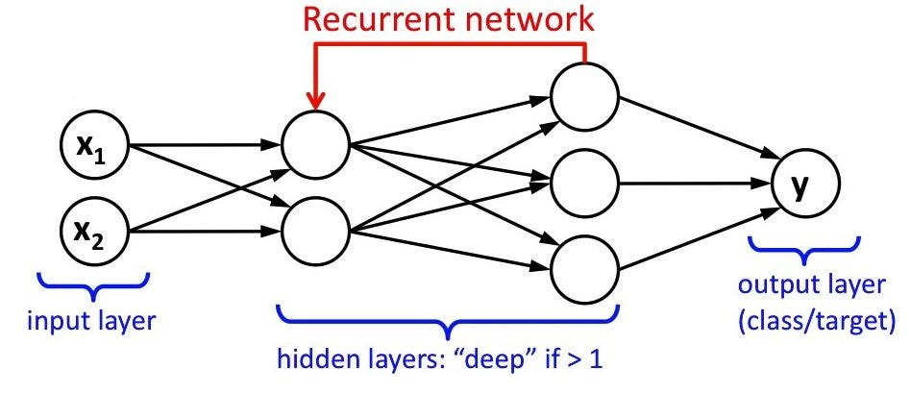
B.TECH MAJOR PROJECT PRESENTATION 2024-25
PROPOSED MODEL
Recurrent Neural Networks (SimpleRNN):
RNN are a type of neural network specifically designed for sequential data, making them suitable for tasks where data has a temporal or sequential order.
RNNs have a unique architecture that allows them to retain information from previous steps in a sequence, enabling them to capture context across time steps.
RNNs are widely used in applications like time-series forecasting, language processing, speech recognition, and video analysis, where understanding the sequence of data is critical.
RNNs are well-suited for shorter sequences and simpler sequential data patterns, but they can struggle with retaining information over longer sequences due to the vanishing gradient problem.
RNNs can be more computationally efficient than advanced models but may face limitations in learning long-term dependencies, which can lead to reduced accuracy for complex, lengthy sequences.
202110040 Subrata Kumar Sahu
202110068 Anwesh Misra
202140086 A. Sai Satyanarayana
202110043 Soumya Kanta Moharana
11

Slide 13
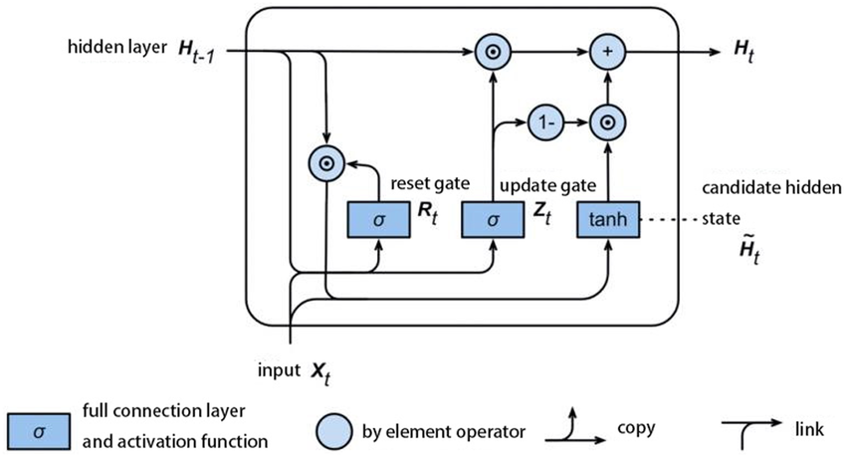
B.TECH MAJOR PROJECT PRESENTATION 2024-25
PROPOSED MODEL
Gated Recurrent Unit (GRU):
GRUs are a type of recurrent neural network (RNN) designed to handle sequential data efficiently by addressing the vanishing gradient problem.
GRUs have a simplified architecture compared to LSTMs, using only two gates—reset and update—to regulate Information flow.
GRUs are widely used in applications like speech recognition, machine translation, text generation, and time- series forecasting, where sequential data processing is essential.
GRUs are computationally more efficient than LSTMs, making them well-suited for tasks requiring faster training and inference with fewer parameters.
GRUs perform well on smaller datasets and shorter sequences but may not always capture very long-term dependencies as effectively as LSTMs.
202110040 Subrata Kumar Sahu
202110068 Anwesh Misra
202140086 A. Sai Satyanarayana
202110043 Soumya Kanta Moharana
12

Slide 14
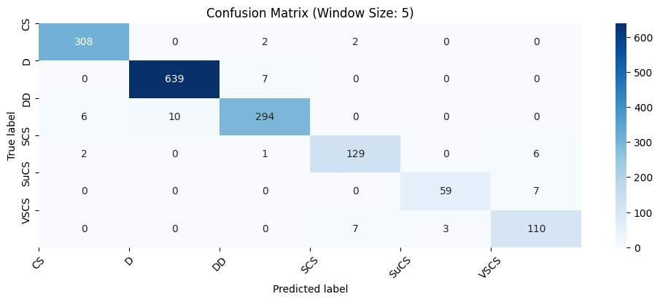
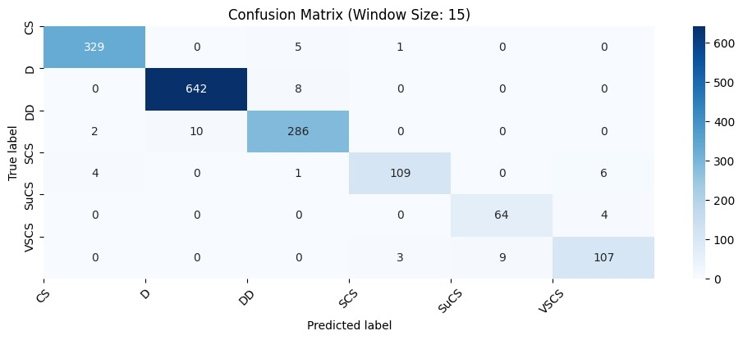

B.TECH MAJOR PROJECT PRESENTATION 2024-25
MODEL EVALUATION
Confusion Matrix:
The confusion matrix is a summary of prediction results on a classification problem. It shows the number of true positive, false positive, true negative, and false negative predictions, giving insights into the performance of a model.
LSTM
SimpleRNN
GRU
202110040 Subrata Kumar Sahu
202110068 Anwesh Misra
202140086 A. Sai Satyanarayana
202110043 Soumya Kanta Moharana
12

Slide 15
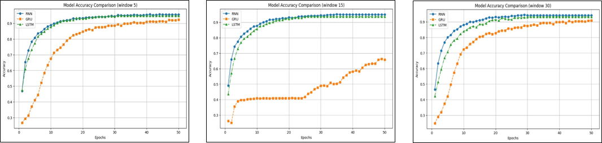
B.TECH MAJOR PROJECT PRESENTATION 2024-25
Accuracy vs Epoch
Window 5
Window 15
Window 30
202110040 Subrata Kumar Sahu
202110068 Anwesh Misra
202140086 A. Sai Satyanarayana
202110043 Soumya Kanta Moharana
15

Slide 16
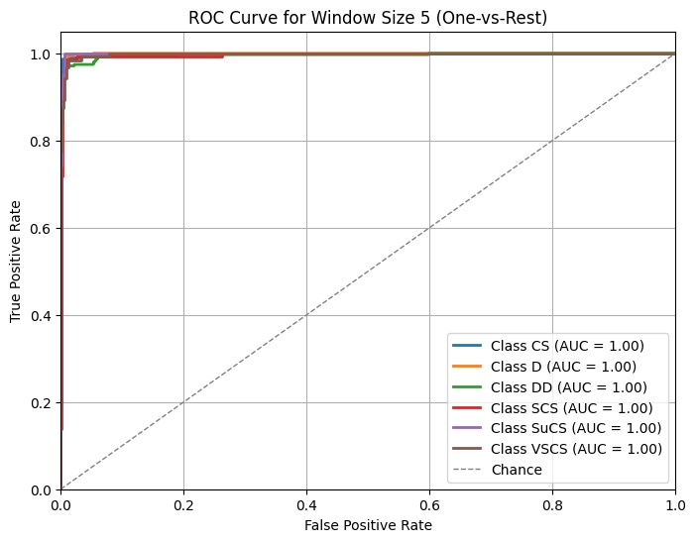
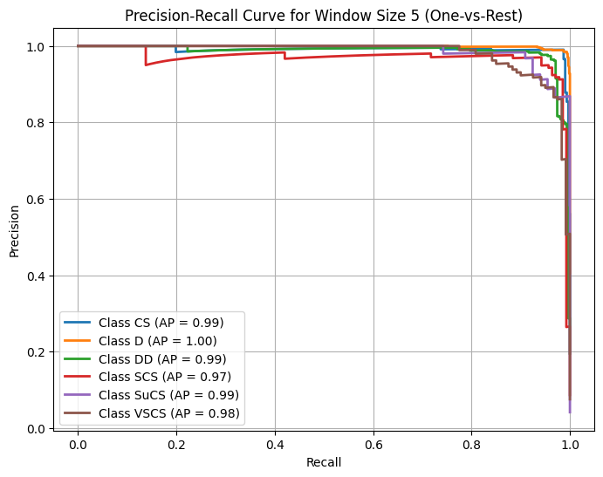
B.TECH MAJOR PROJECT PRESENTATION 2024-25
Contd..
202110040 Subrata Kumar Sahu
202110068 Anwesh Misra
202140086 A. Sai Satyanarayana
202110043 Soumya Kanta Moharana
15

Slide 17
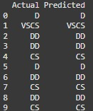
B.TECH MAJOR PROJECT PRESENTATION 2024-25
This table compares actual vs. predicted cyclone intensity grades, showcasing the model's accuracy in classifying different storm severity levels.
202110040 Subrata Kumar Sahu
202110068 Anwesh Misra
202140086 A. Sai Satyanarayana
202110043 Soumya Kanta Moharana
13

Slide 18
B.TECH MAJOR PROJECT PRESENTATION 2024-25
CONCLUSION
This project demonstrates the potential of machine learning, specifically Recurrent Neural Networks (RNNs), Long Short-Term Memory (LSTM) and Gated Recurrent Networks (GRU), to significantly enhance cyclone prediction accuracy. By analyzing historical weather data, these models can better identify patterns in cyclone formation, intensity, and trajectory, overcoming many limitations of traditional forecasting methods. Accurate and timely predictions allow authorities to issue more reliable warnings and implement targeted preparedness measures, helping to minimize the devastating impacts of cyclones on vulnerable communities.
202110040 Subrata Kumar Sahu
202110068 Anwesh Misra
202140086 A. Sai Satyanarayana
202110043 Soumya Kanta Moharana
16

Slide 19
B.TECH MAJOR PROJECT PRESENTATION 2024-25
FUTURE ASPECT
Comparative Analysis: Further research can compare LSTM, RNN and GRU models across different datasets to evaluate accuracy, stability, and efficiency.
Automation Enhancements: Implementing automated hyperparameter tuning and real-time data processing can improve forecasting efficiency.
Multimodal Data Integration: Incorporating satellite imagery, oceanic sensors, and atmospheric data can enhance prediction accuracy.
Hybrid Model Development: Combining LSTM, GRU and RNN can leverage their strengths for improved short- and long-term forecasting.
Extreme Weather Adaptability: Extending models to predict hurricanes, typhoons, and tornadoes can improve disaster preparedness.
202110040 Subrata Kumar Sahu
202110068 Anwesh Misra
202140086 A. Sai Satyanarayana
202110043 Soumya Kanta Moharana
15

Slide 20
B.TECH MAJOR PROJECT PRESENTATION 2024-25
J. Senthil Kumar; V. Venkataraman; S. Meganathan; Kannan Krithivasan (2023). Tropical Cyclone Intensity and Track Prediction in the Bay of Bengal Using LSTM-CSO Method
Hill, T., O’Connor, M., & Remus, W. (1996). Neural network models for time series
Li, Y., Wu, H., & Liu, H. (2018). Multi-step wind speed forecasting using EWT decomposition. LSTM principal computing. RELM subordinate computing and IEWT reconstruction. Energy Conversion and Management.
Qin,Y., Song, D., Chen, H., Cheng, W., Jiang, G., & Cottrel, G. W. (2017). A Dual Stage Attention-Based Recurrent Neural Network for Time Series Prediction
Ribana Roscher, Bastian Bohn, Marco F. Duarte, and Jochen Garcke [2019]. Explainable Machine Learning for Scientific Insights and Discoveries.
Subrata Paul, Vidhi Singrodia, and Anirban Mitra, [2024]. Understanding the requirements of the Indian IT industry using web scrapping.
Buo-FuChen, Yu-TeKuo, Treng-ShiHuang [2022]. A deep learning ensemble approach for predicting tropical cyclone rapid intensification.
Shuxian Liu, Yang Liu, Zhigang Chu, [2023] Evaluation of Tropical Cyclone Disaster Loss Using Machine Learning Algorithms with an eXplainable Artificial Intelligence Approach
202110040 Subrata Kumar Sahu
202110068 Anwesh Misra
202140086 A. Sai Satyanarayana
202110043 Soumya Kanta Moharana
17

Slide 21
B.TECH MAJOR PROJECT PRESENTATION 2024-25
Thank You
18

